Slide 1

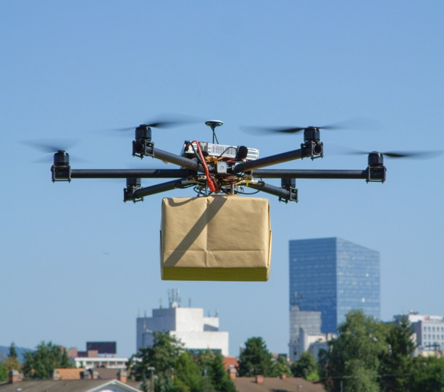
Session 9
Notes:
Checkpoint 2
The team has completed all the robot lessons outlined in the sessions.
The team has selected an Innovation Project problem and solution and conducted research.
Provide the team with the judging flowchart and judging rubrics.
Visit the FIRST® LEGO® League Challenge Season Resource page to print copies of the rubrics (Core Values, Innovation Project, and Robot Design) and any other information that will help you prepare for your event.
Facilitator Tips Session 9-12
Core Values: Make sure the team can provide concrete examples of the Core Values in use by the team. Don’t forget Coopertition® and Gracious Professionalism®.
Innovation Project: The team will need plenty of time to iterate, improve, and build a model or prototype of their idea. From Session 9 on, they should focus only on their final solution.
Robot Design: The team should bring their robot, all the LEGO® attachments, and their computer or program printouts to their judging session when they provide their explanation to the judges. Remind the team to include their mission strategy.
Robot Game: The team needs a well-practiced and reliable robot run that they know will score them points. If they have time, they can have additional runs to score more points.

Slide 2

Session Overview
Outcomes
The team will code their robot to deliver their Innovation Project model and solve missions.
The team will test, iterate, and improve their Innovation Project solution.
Notes:
Facilitator Tips

Slide 3

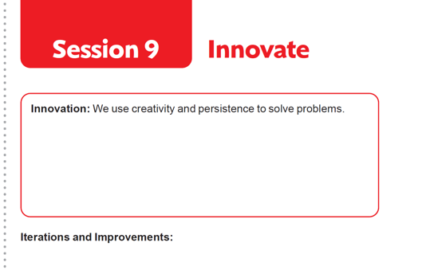

Introduction
Think about Innovation and your team.
Record examples of how your team has been creative and solved problems.
Notes:
Facilitator Tips
Have the team discuss how the Guided Mission is an example of Coopertition®.

Slide 4
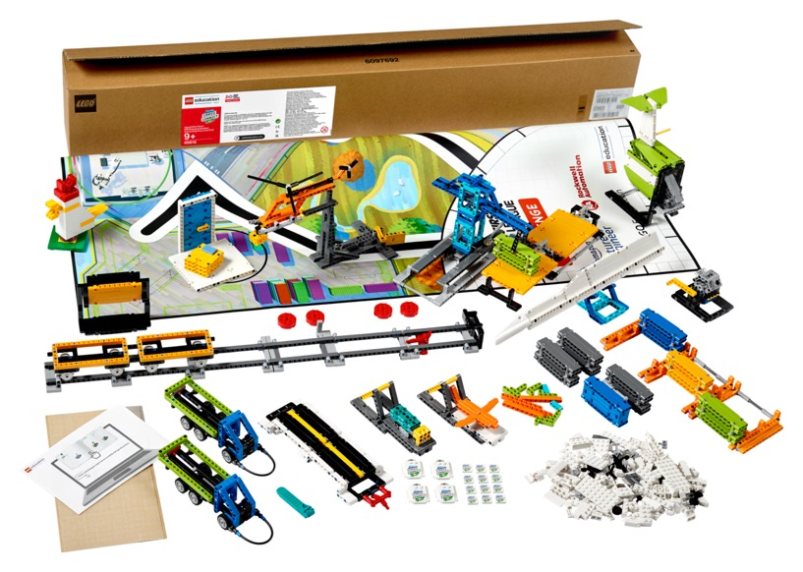
Iterate and Improve
Code your robot to complete Innovation Project mission (M01) using the model you created.
Think about your mission strategy on the mat and the missions you will solve.
Continue to create a solution for each mission as time allows.
Notes:
Facilitator Tips
The team should think about strategy when choosing missions to solve. Multiple missions can be completed on the same run to save time.
Encourage the team to discuss how their program works. Break the program into blocks that control one movement.
Treat the Robot Game like a sport. The team needs to practice, practice, practice to perform well in the Robot Game.
Where the robot starts strongly influences where it ends. Have team keep good notes about where the robot is placed.

Slide 5
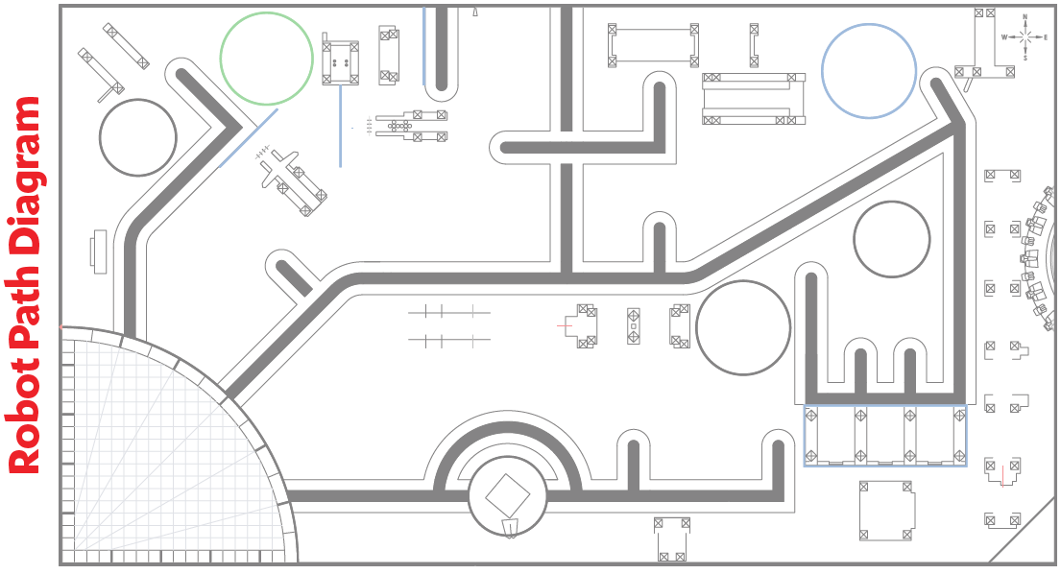
Iterate and Improve

Slide 6

Iterate and Improve
Test, iterate, and improve your robot and Innovation Project solutions. Be sure to document all this.
Notes:
Facilitator Tips
Keep the white brick model made by the team representing their Innovation Project solution.
Collect the remaining white bricks from Bag 16 in a sealed plastic bag. They do NOT have to use all the white bricks.
The team should iterate and improve their project solution following feedback from others.
The team can create a survey to evaluate their solution or ask for feedback from someone who is an expert on their chosen problem.
The team could go through multiple cycles of the Engineering Design Process as they test and improve their project solution.

Slide 7
Share
Get together at the mat.
Show the work completed on the Innovation Project and Robot Game.
Look over the Core Values rubric. Talk about how you will demonstrate Core Values at the event.
Clean up your space.
Notes:
Facilitator Tips
Provide the team with the Core Values rubric. Find it here: firstlegoleague.org/ season#resources.
The Share tasks are important to keep the whole team updated on how the project and the robot are developing.

Slide 8
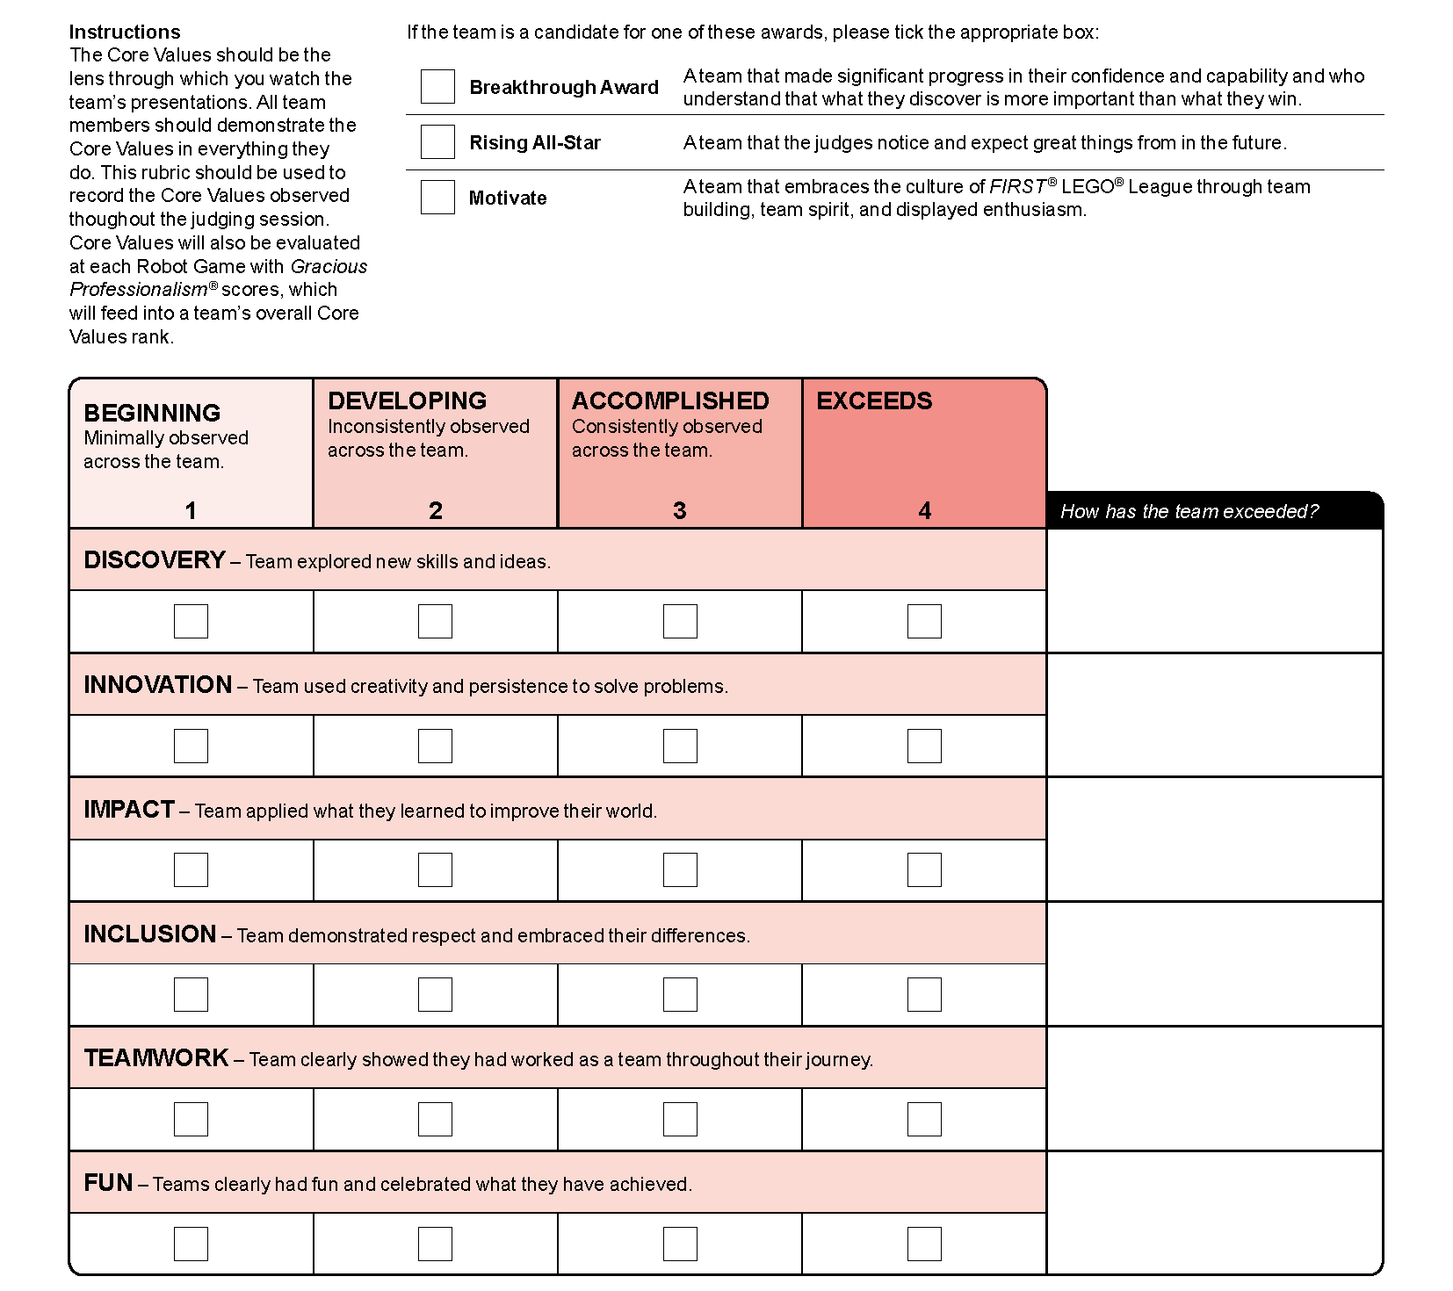
Core Values Rubric
Notes:
Facilitator Tips
Find the rubrics in the FIRST LEGO League season resources (https://www.firstlegoleague.org/season#resources)

Slide 9

Reflection Questions
What features on your robot show good mechanical design?
Have you made changes to your project solution based on advice from others during sharing?
How does an engineer create innovative designs?

Slide 10

Multimedia Resources
You may wish to embed a relevant, age-appropriate video for your students here. See the Notes for an example.
Notes:
Choose a relevant, age-appropriate video for your students.
Here is one example:
How Google builds the perfect team from Tech Insider – Length 2:22
https://youtu.be/v2PaZ8Nl2T4

Slide 11

Clean Up

Slide 12

FIRST® and the FIRST® logo are registered trademarks of For Inspiration and Recognition of Science and Technology (FIRST). LEGO® and MINDSTORMS® are registered trademarks of the LEGO Group. FIRST® LEGO® League and CARGO CONNECTSM are jointly held trademarks of FIRST and the LEGO Group. SPIKE™ Prime is a trademark of LEGO® Education. All other trademarks are the property of their respective owners. ©2021 FIRST and the LEGO Group. All rights reserved.

